Slide 1
Audit Management System
Team 1 : Cohort 24
- Nilotpal Ghosh
- Haseeb Raza
- Sheena Narula
- Rishabh Thakral

Slide 2
Table of Content
Problem Statement
Approach towards Solution
Use-Case Diagram
Flow of the program
Backend - Microservices
Frontend - Angular app
Project Timeline

Slide 3
Problem Statement
A leading Supply chain Management Organization wants to automate the Audit processing, to make the management scalable and ensure clarity and ease of tracking. Organization want us to develop an audit management system. We were requested to develop and deploy four microservice and deploy them in Amazon web services(AWS). We were also needed to build UI on angular.

Slide 4
Approach towards Solution
01
We read the requirements given in SRS. We discussed and divided work among ourselves. Then we started developing microservices and the User Interface after creating a git repository and sharing our local work in that repository.
02
After microservices are developed in local system, we started integrating and testing microservices and UI together.
03
In final step we deployed microservices on Microsoft Azure.

Slide 5
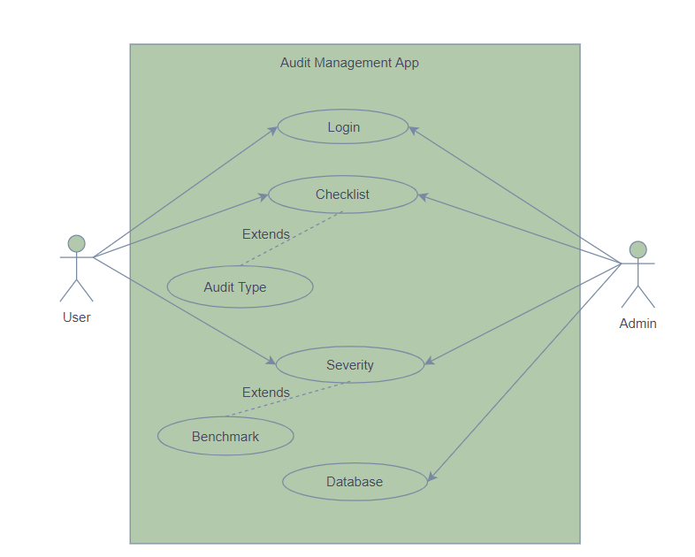
Use-Case Diagram

Slide 6
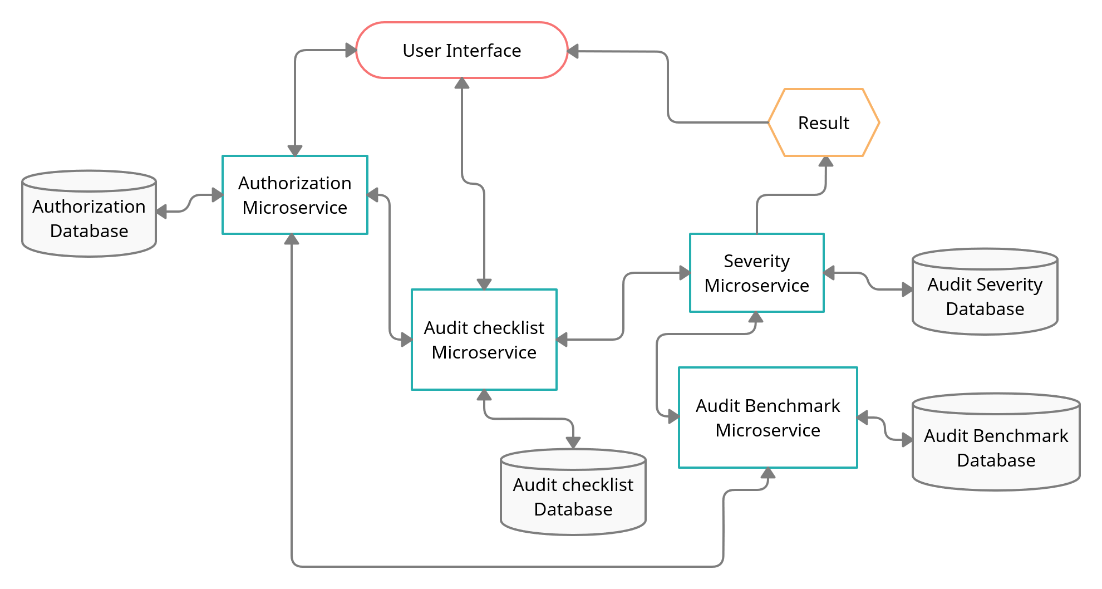
Flow of the Program

Slide 7
Backend - Microservices
There are 4 microservices in our project:
Authorization Microservice
Audit Checklist Microservice
Audit Benchmark Microservice
Audit Severity Microservice

Slide 8
Authorization Microservice
This module is used for doing the Authentication and Authorization part of our project.
This microservice provides the endpoints for authentication and validation.
This MS creates JWTs (JSON Web Token) for a authenticated user who is in Database and then it validates the user based on the JWT token passed in the "Authentication"-Request-Header ("Bearer j.w.t...").
Method:
GET:/health-check
POST:/authenticate
POST:/validate

Slide 9
Audit Checklist Microservice
Audit checklist microservice is a middleware microservice.
This microservice is used to get the list of questions from H2 database.
The returned list is used by the UI to display question based on the type selected by the user.
Method:
GET:/AuditCheckListQuestions
GET:/health-check

Slide 10
Audit Benchmark Microservice
Audit Benchmark is a middleware microservice.
This microservice stores the number of acceptable “No” in the database.
Upon request it returns data as a list in a user-defined AuditBenchmark datatype.
It is used to pass the number of acceptable “No” or the benchmark, in other words, to audit severity microservice.
Method:
GET:/AuditBenchmark
GET:/health-check

Slide 11
Audit Severity Microservice
Audit Severity is a middleware microservice.
This microservice invokes audit benchmark microservice and takes number of acceptable “No” from it.
It then checks the project execution status according to the pre set rules.
It returns the status and remedial action to be taken.
Method:
POST:/ProjectExecutionStatus
GET:/health-check

Slide 12
Frontend - Angular App
The flow of our Angular app according to the Requirement:
Audit management Portal must allow a member to Login.
Once successfully logged in, the member do the following operations:
Choose the audit type to view the list of audit checklist questions
Let the project manager provide answers to the questions
Invoke the Audit Severity Microservice to determine the project execution status
Display the result on the Web UI
The audit response detail along with the project execution status and remedial action duration should be saved to the database

Slide 13
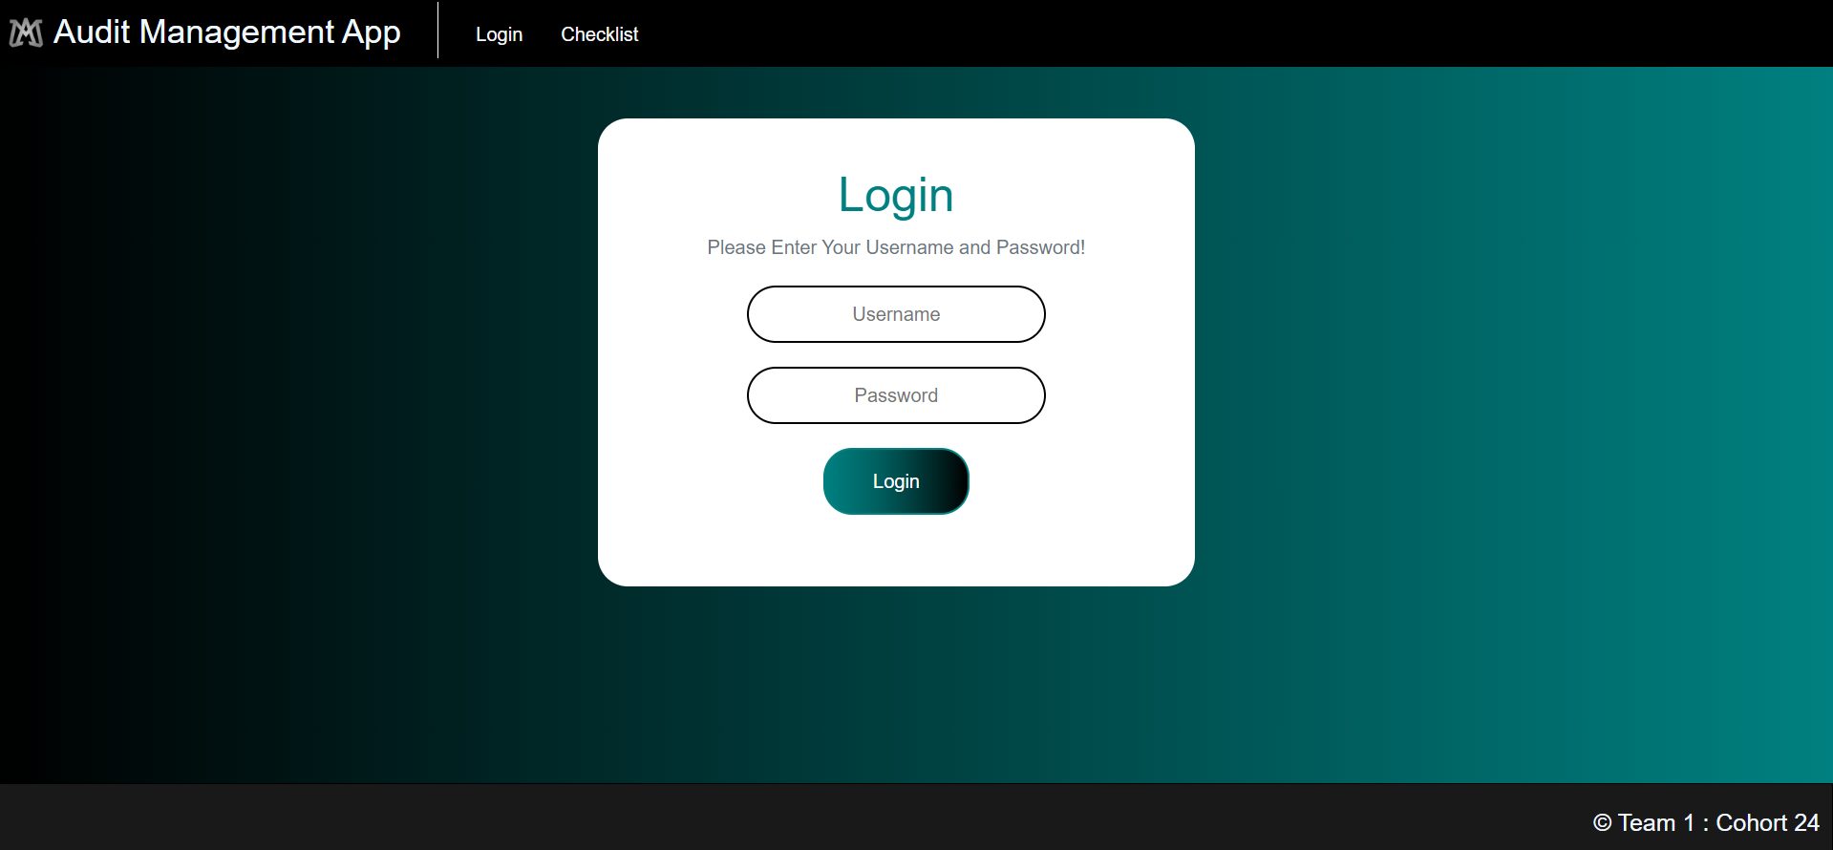
Login Screen

Slide 14
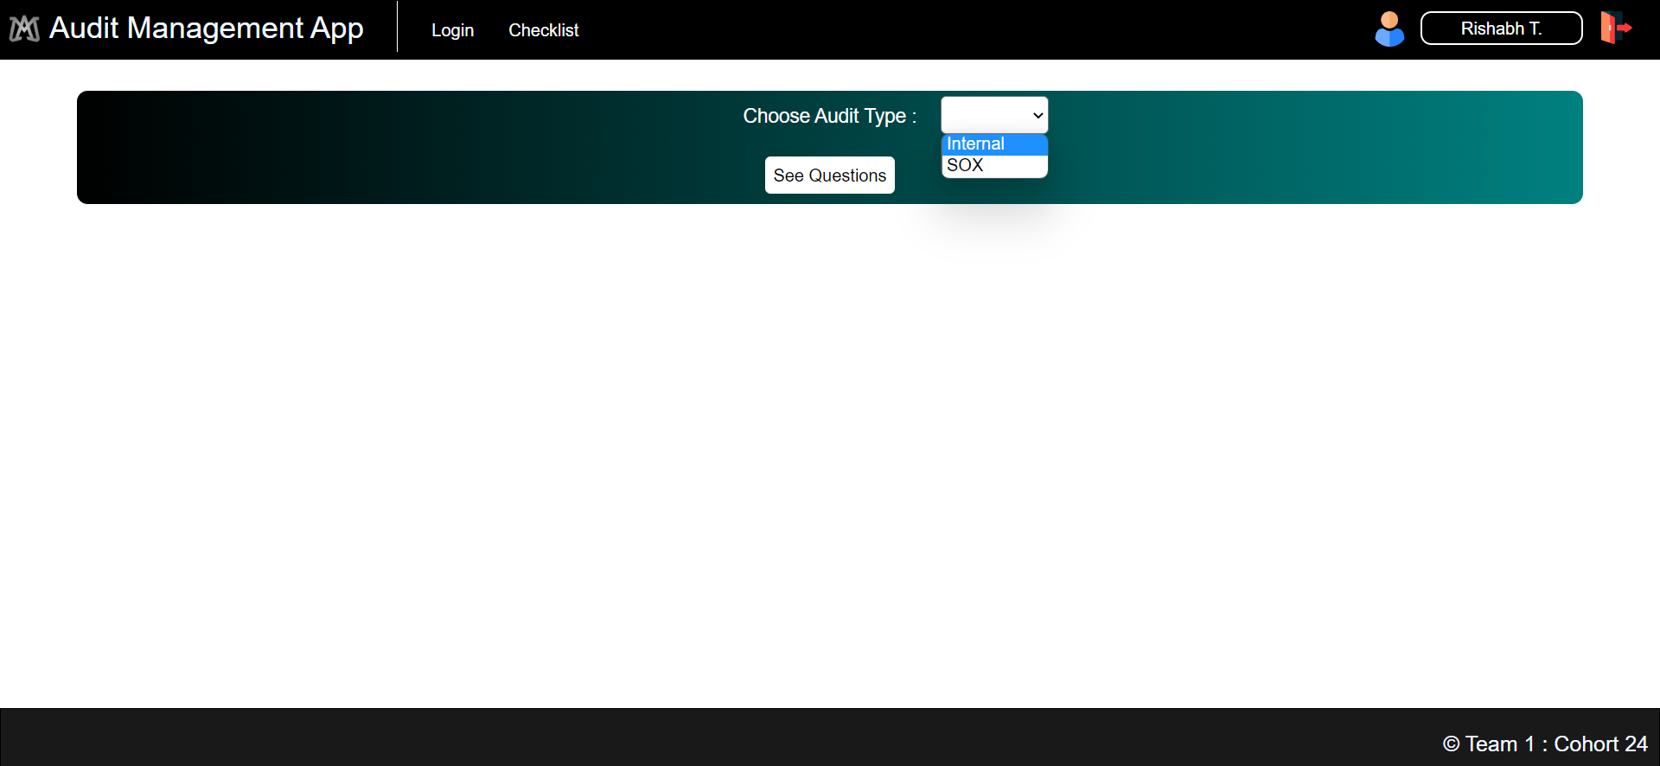
CheckList Screen - 1

Slide 15
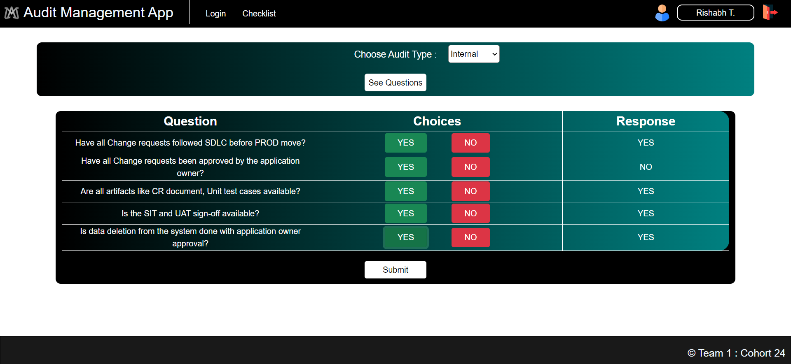
CheckList Screen - 2

Slide 16
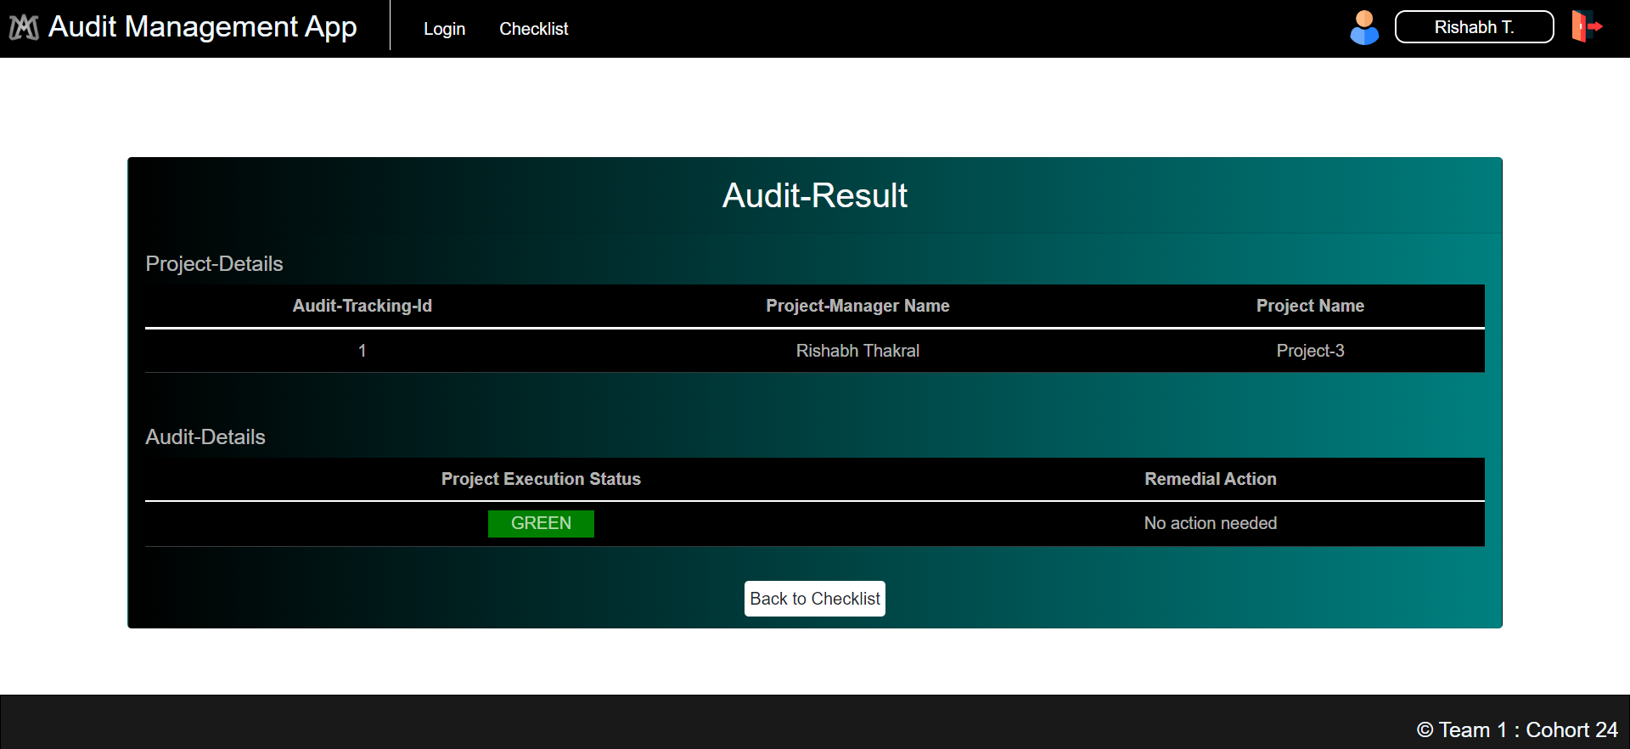
Status Screen

Slide 17
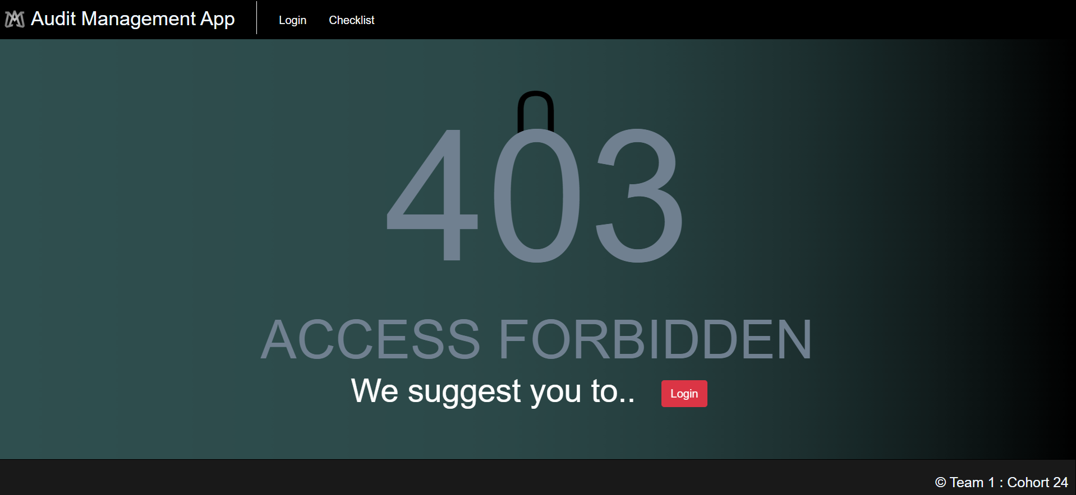
Error Screen - 1

Slide 18
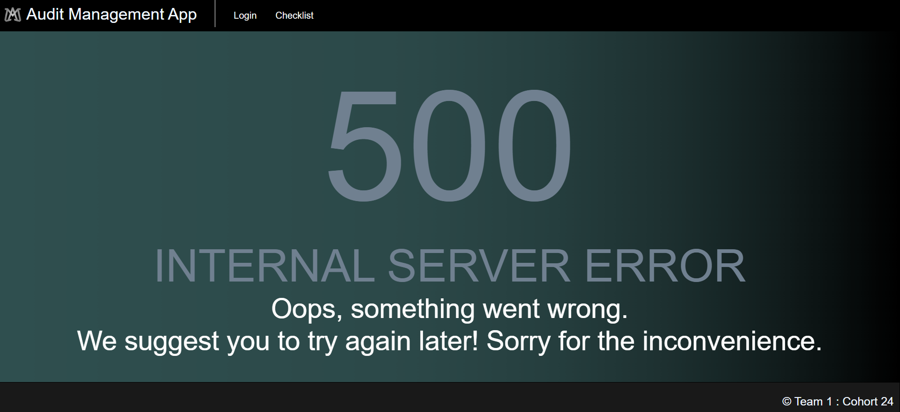
Error Screen - 2

Slide 19
Project Timeline
Day1
Day2
Day4
Day7
Day10
Day11
14th July
Design Phase
Backend
Testing
Frontend UI and Testing
Azure Deployment
Project Completion
GitHub Link : https://github.com/Nil3110/Audit-Management-System

Slide 20
Thank you!

